Slide 1




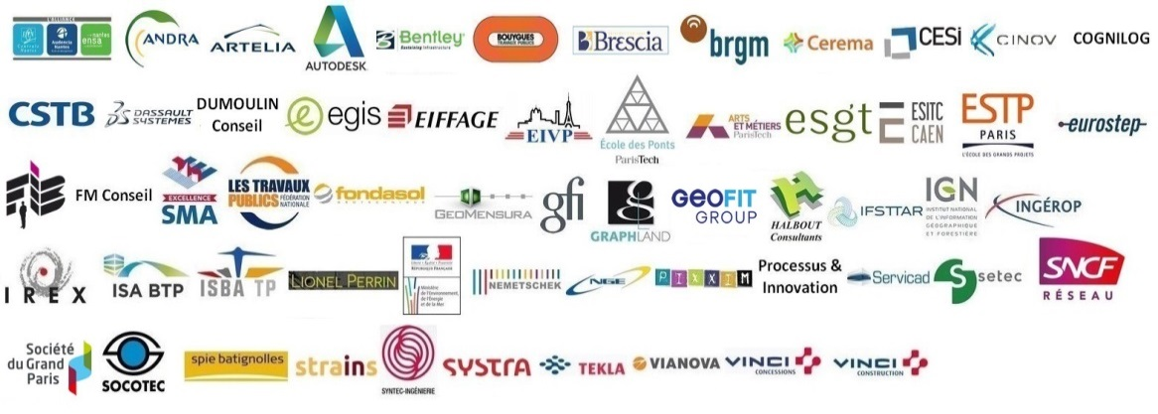









The MINnD UC8-GT proposition for Geotechnics
Geotechnical Data Standardization Workshop
Mickael Beaufils (BRGM), on behalf of the MINnD UC8-GT team
Tuesday 22 january 2019 – Paris

Slide 2

Context: MINnD
MINnD (2014-2018 > 2021)
A French collaborative program to extend BIM methods and standards from building to infrastructure modeling
Organized by themes and use cases
UC: Bridge, Rail, Road, Underground Infrastructures
Themes: Change management, experimentation, law aspects
71 partners
MINnD UC8: Underground Infrastructures (mid 2017-2018)
Two teams:
GC: describe construction and equipments > Tunnel
GT: describe environment and interaction with construction > Geotechnics
22/01/2019
Geotechnical Data Standardization Workshop - Paris

Slide 3











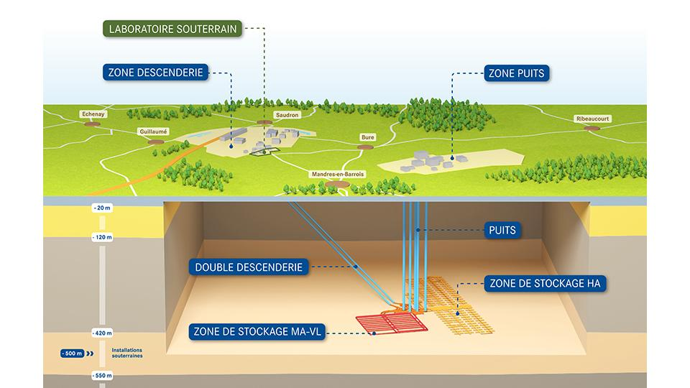


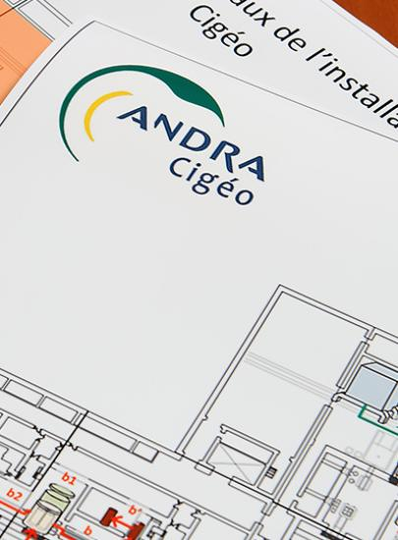
MINnD UC8-GT: Geotechnics
40 people from 13 organizations
Public institution
Engineering
Proposing standards for geotechnical data expression and exchange
Based on NFP 94-500 and AFTES guides, members experience and current projects
Constructor
Freelance experts
22/01/2019
Geotechnical Data Standardization Workshop - Paris

Slide 4



The MINnD UC8-GT objectives
Better Information Management (BIM?)
For geotechnical engineers work from data collection to proposition of interpretations / results
For geotechnical engineers and civil engineers collaboration at the BIM age
1111000101101
10011101100010
Geoengineering
team
Civil engineering
team
Topics we looked at
Identifying the actors, the processes and the data exchanged
Data description: define the right semantic to use
Data access: enable independant access to each important information
Data lineage: highlight and exploit the links between data / actions
Solutions sustainability / maturity / existence of communities
22/01/2019
Geotechnical Data Standardization Workshop - Paris

Slide 5






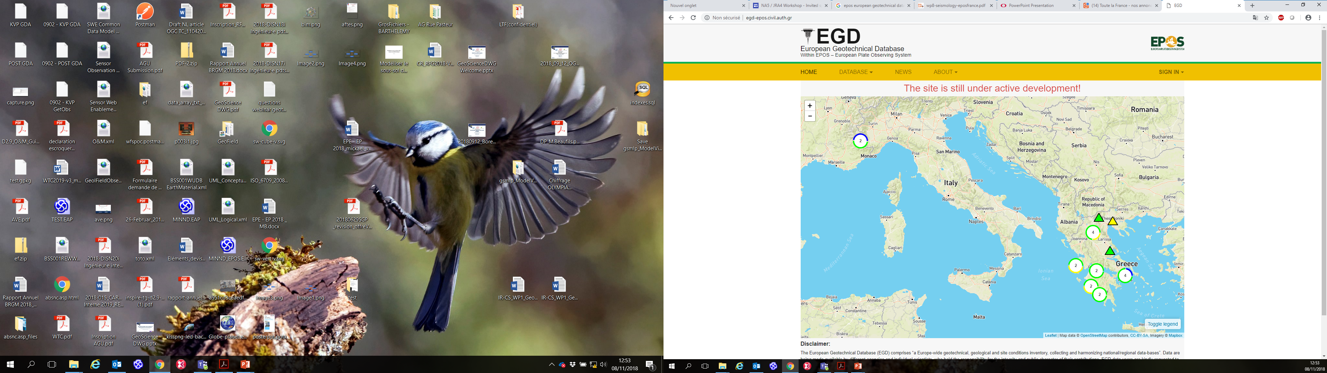

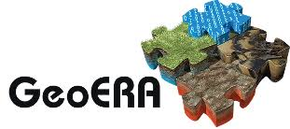





Trying to connect to existing initiatives, reuse standards
GeoScience DWG
Earth, Space, and Environmental Sciences
Interest Group
22/01/2019
Geotechnical Data Standardization Workshop - Paris

Slide 6
Interesting data models / standards to consider
Concepts to address | Helpful existing models
Observations on the field | ISO O&M / OGC GeoSciML Outcrop / AGS
Measurements | ISO O&M / AGS
Results of calculus / estimations | ISO O&M
Lab analysis | OGC GeoSciML / AGS
Geology logs | OGC GroundWaterML2
Boreholes | Borehole IE (on going activity)
GeologicUnit / GeologicStructure and specializations | OGC GeoSciML
Aquifer, fluid bodies, void, flows | OGC GroundWaterML2
Existing buildings | OGC CityGML / INSPIRE BU
Existing infrastructures | OGC LandInfra / InfraGML
Existing networks | OGC CityGML + UtilityNetwork ADE / INSPIRE UN
Risk zones | INSPIRE NZ
Survey / Campaign | INSPIRE Geology>Geophysics>Campaign
Geomodel | OGC GeoSciML>Geophysics package (O&M)
22/01/2019
Geotechnical Data Standardization Workshop - Paris

Slide 7

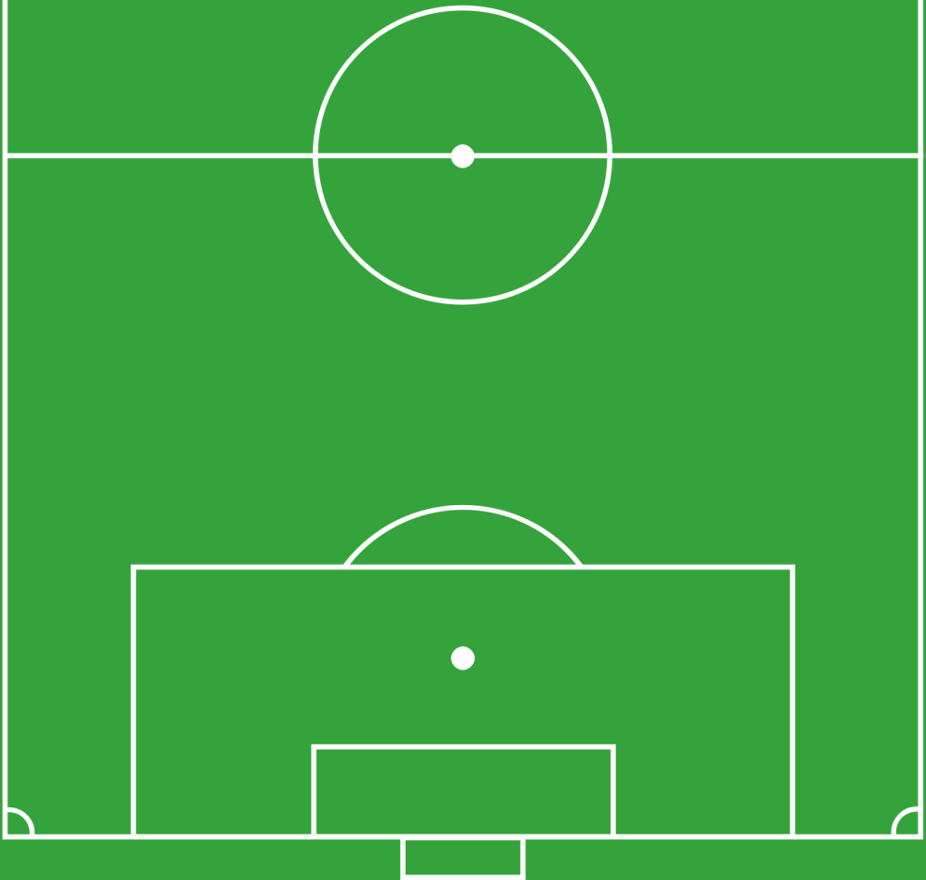
Defining the MINnD UC8-GT perimeter
Designation | Id
Structure sizing and definition of the geotechnical influence zone | CALC
Construction methods | MECO
Geological modeling | GEOL
Hydrogeological modeling | HYDR
Geotechnical modeling | GTCH
Anthropic environment modeling | AVOI
Excavations and Site Pollution modeling | TESP
Observations and Measurements | RECO
Risk and uncertainty assessment | RISK
MECO
CALC
Draft
conception
Plan
GTCH
TESP
AVOI
Environment
Modeling
GEOL
HYDR
RECO
Factual data
collection
RISK
22/01/2019
Geotechnical Data Standardization Workshop - Paris

Slide 8
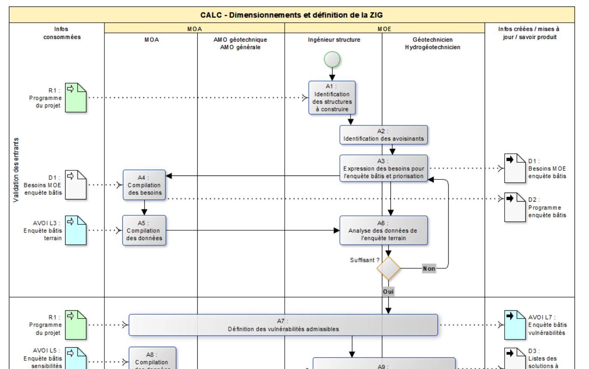

IDM for expliciting the geotechnical activity processes
Information Delivery Manual (IDM)
Workflow description
ISO 29481-1:2016
1 per subject
Highlight basics
Who does what?
Which data?
Which results?
Focus on knowledge construction
Not methods and tools
Only available in French for now
Actors
Processes
Input data
Output data
22/01/2019
Geotechnical Data Standardization Workshop - Paris

Slide 9
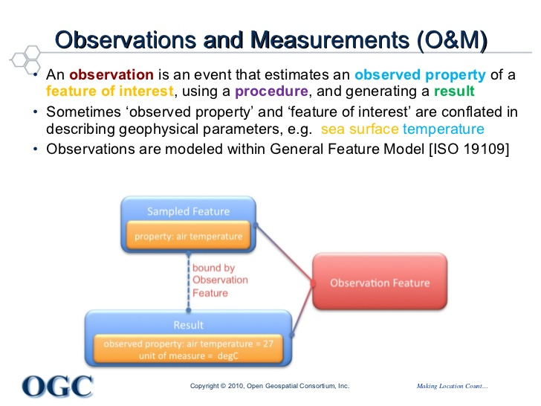
Standardizing the factual data / O&M
Done:
Identification of observations, measurements, tests analysis made for environmental modeling
Expression according to ISO 19156: Observations and Measurements
Overview mapping with AGS semantics
Proposition:
Experiment OGC SWE protocols SOS / Sensorthings API to expose those data
22/01/2019
Geotechnical Data Standardization Workshop - Paris

Slide 10
Standardizing the geomodeling part: challenges
A model is a conceptualization of how the geoscientist think the environment is and behave based on the available data, its interpretation, with uncertainties
Representations help mind sharing and computation, yet can introduce biases and simplification
Eg. metro map (path between stations as a straight line), strenght of materials (beam as a line) where geometries are simplified
Two challenges:
How to capitalize the knowledge?
How to provide expected formats to softwares / algorithms?
22/01/2019
Geotechnical Data Standardization Workshop - Paris

Slide 11
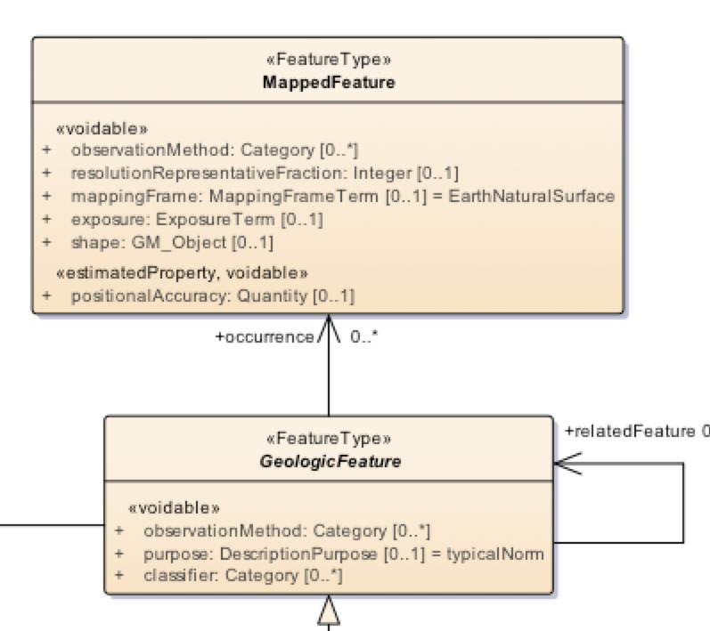
Standardizing the geomodeling part: part of the proposition
Done:
Identification of interesting parameters / attributes to connect to geoscience features to dimension structures
Proposition:
Distinction between Feature / Its representation (as proposed in GeoSciML)
Enable « multiple representations »: 1D (log), 2D(section) and 3D
Enable separate refinements of geometries and attributes
As for GeoSciML
22/01/2019
Geotechnical Data Standardization Workshop - Paris

Slide 12
Connection between BIM and GeoScience data: challenges
Some thoughts:
Today real 3D geomodelling is only 10% of geotechnical engineering projects
Several geomodeling tools exists and can be used
Geomodels are conceptualized in 3D, yet is it the way they are exchanged from geotechnical engineers to civil engineers ?
Our proposition have to anticipate the future, yet we shall also take care to current practices
Consider formats data in which data are available
Consider data formats algorithms can compute
22/01/2019
Geotechnical Data Standardization Workshop - Paris

Slide 13
Connection between BIM and GeoScience data: a proposition
Think using web services to retrieve data instead of import / export
Ex: from geomodels to soil structure computation
Geomodeling tool
GetVirtualBorehole
web service
Soil structure tool
Geomodel
Collection of virtual boreholes
Geomodel built from boreholes
Geomodel
export
import
Soil structure computation
CAD tool
Simplified construction
Infrastructure model
Built
environment
export
import
GetLOD1Building
web service
22/01/2019
Geotechnical Data Standardization Workshop - Paris

Slide 14
Connection between BIM and GeoScience data: a proposition
Think using web services to retrieve data instead of import / export
Do we need to get 3D objects to get properties of a Geologic Layer ?
Geomodeling tool
CAD tool
Geomodel exposed
with web services
X,Y,Z coordinates
Identifier of the geologic feature
at this point
GeoScience Information System
Database expose with web services
Identifier of the geologic feature
at this point
Attributes of that feature
22/01/2019
Geotechnical Data Standardization Workshop - Paris

Slide 15
Conclusion: The MINnD UC8-GT propositions
A large majority of components we need (semantic, web server) are already existing
Let’s experiment together
22/01/2019
Geotechnical Data Standardization Workshop - Paris

